Slide 1
Real Estate Property Management Platform

Slide 2

Executive Summary
Vision
Our vision is to be the most user-friendly, efficient, and comprehensive property management platform, empowering small and independent property managers to streamline operations and grow their businesses.
Mission
Our mission is to provide an all-in-one solution for landlords and property management companies, handling tenant relations, rent collection, maintenance requests, and more.
Business Name
This business plan focuses on a platform called 'Example Name' that delivers these solutions.

Slide 3

01
Canada’s real estate market has over 33% of citizens renting properties, presenting a vast opportunity.
02
Real estate investing is popular, creating a need for better management tools.
Market Analysis
03
Challenges include regulatory complexities and hesitation to adopt new technology.
04
Opportunities exist with rising rental demands and a focus on localization.
05
The platform addresses affordability and accessibility for small landlords.

Slide 4
Competitor Landscape
Key Competitors
Competitive Edge
Challenges and Opportunities
Buildium: Robust but expensive for small landlords. AppFolio: Targets large landlords, making it less suited for individuals. TenantCloud: Affordable but lacks localized Canadian features.
Province-specific compliance tools, bilingual (French-English) support, accessible pricing tiers, and AI-driven insights.
Regulatory hurdles pose challenges. Opportunities lie in growing rental demand and under-served small landlords.

Slide 5

Revenue Streams
Subscription pricing: $19/month (Basic) to $99/month (Pro).
Transaction fees: 1-2% on each rent payment.
Add-ons and commissions: Premium features such as background checks and insurance.
Financial Strategy
Projected Revenue:
Year 1: $50,000-$100,000 with 100-200 users.
Year 2: $250,000-$500,000 with 500-1000 users.
Year 3: $1 million with 2000+ users.

Slide 6

Who drives business growth?
How are leads generated?
Alex: Focuses on partnerships, customer acquisition, and marketing.
Johnathan: Specializes in lead generation, earning $50 per 20 leads.

Slide 7
Development Roadmap
Month 1-2
Month 3-6
Month 7-12
Develop the MVP with core features: tenant communication, rent collection, and maintenance.
Launch mobile app, add AI-based analytics, and community marketplace features.
Beta testing, refine features based on feedback, and expand platform integrations.

Slide 8

Step-by-Step Timeline
Months 1-3
Conduct market research, outline technical requirements, and develop the MVP with essential features like tenant profiles, rent collection, and maintenance tracking.
Months 4-6
Beta test with early adopters, refine the product, and finalize marketing materials including a professional landing page.
Months 7-12
Public launch, scale platform functionalities, and add advanced features such as vendor marketplaces and compliance automation.

Slide 9
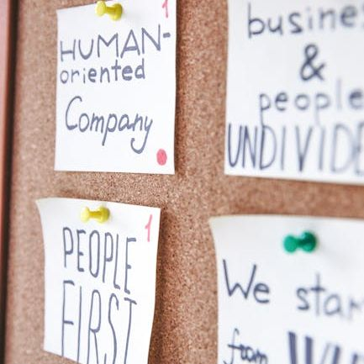
Development Priorities
Tenant Profiles
Store tenant data, lease details, and communication history in an organized manner.
Rent Collection
Simplify the rent payment process with automated reminders and receipts.
Maintenance Tracking
Allow tenants to submit and track maintenance requests through a portal or voice assistant.

Slide 10
Real Estate Innovation
How will this platform transform property management?
Conclusion and Next Steps
This platform will simplify operations, empower landlords with AI-driven insights, and provide tenants with a seamless experience, setting a new standard for property management.

